Slide 1
Big Mountain Resort
Data Analysis
By James Lo

Slide 2
Problem Statement Worksheet (Hypothesis Formation)
How can Big Mountain Resort overcome this season’s ~$1.5 million increase in operating costs by the end of this season by emphasizing value and adjusting ticket prices accordingly, while at the minimum maintaining profits?
1 Context In order to increase the distribution of visitors, Big Mountain Resort (BMR) has recently installed an additional lift that increases this season’s operating costs by ~$1.5 million. To maintain or possibly increase profitability, BMR is looking to implement data-driven, value-based ticket pricing in addition to implementing data-driven cost cutting measures that will increase profitability. 2 Criteria for success A value-based ticket price based on market competition and BMR’s facilities. 3 Scope of solution space Determine the effect of the many variables including (but not limited to) number of chairs, elevation, vertical drop, region, longest runs, etc. on pricing (if any). Thoroughly examine if region plays a role in pricing. Determine an appropriate value-based ticket price based on data. | 4 Constraints within solution space Data sources are restricted to the provided CSV file. In-house metrics and financial data from BMR are not available. 5 Stakeholders to provide key insights Jimmy Blackburn (Director of Operations) Alesha Eisen (Database Manager) 6 What key data sources are required? CSV file of US ski resort data provided by Alesha Eisen (Database Manager)

Slide 3
Ticket Price Recommendations and Key Findings
How can Big Mountain overcome the $1.5 million dollar increase in operating costs from installing the lift?
Increase Ticket Price by 86 cents!
But even with an 86 cent increase to $81.86, Big Mountain still undercharging!
The expected Big Mountain ticket price is $95.87. A conservative ticket price recommendation:
$85.48

Slide 4
Modeling Results and Analysis
The model suggest that Big Mountain should be charging $95.87 with an expected mean absolute error of $10.39.
The suggested price range factoring in error is $85.48 to $106.26.

Slide 5
Scenario Recommendations and Key Findings
A reminder of the 4 suggested scenarios:
Permanently closing down up to 10 of the least used runs which does not affect any other resort statistics.
Increase vertical drop by adding a run to a point 150 feet lower down but requiring the installation of an additional chair lift to bring skiers back up, without additional snow making coverage.
Same as Scenario 2, but adding 2 acres of snow making cover.
Increase the longest run by 0.2 miles to boast 3.5 miles length, requiring an additional snow making coverage of 4 acres.

Slide 6
Scenario Recommendations and Key Findings
Scenarios 1 and 2 are potentially profitable, but numbers need to be run.
Do not pursue scenarios 3 and 4 since modeling suggests that scenarios 3 and 4 do not support added value to ticket price.

Slide 7
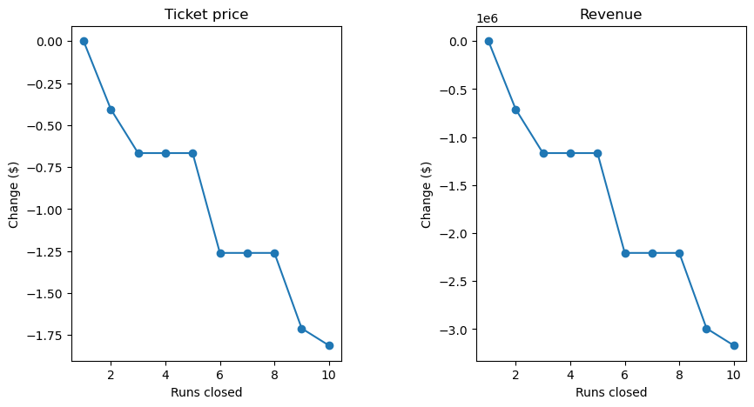
Modeling Results and Analysis: Scenario 1
Closing 1 run does not decrease ticket price predictions.
There is no difference in ticket price predictions whether 3, 4, or 5 runs are closed.
There is no difference in ticket price predictions whether 6, 7, or 8 runs are closed.

Slide 8
Modeling Results and Analysis: Scenario 1
This scenario closes up to 10 of the least used runs.
The important thresholds are detailed in the table.
For further analysis, actual costs associated with:
the closing cost of each run
the operating cost of each run
are needed.
Closing X Number of Runs | Revenue Change (in millions of $)
1 | 0
2 | -0.71
5 | -1.17
8 | -2.21
9 | -2.99
10 | -3.17

Slide 9
Modeling Results and Analysis: Scenario 2
This scenario adds an additional run, increases vertical drop by 150 feet, and installs an additional chair lift.
The implementation of scenario 2 suggests a ticket price increase of $1.99. Over the season, this is expected to amount to $3.47 million.
Again, a cost analysis needs to be run with operating and installation costs.

Slide 10
Summary and Conclusion
An 86 cent increase in ticket prices will cover the increase in ticket prices, however, modeling suggests a price between $85.48 to $106.26.
Scenarios 1 and 2 should be analyzed further.
Results should be looked at optimistically and doubtfully since the modeling assumes that other resorts accurately set prices.
Key data such as operating costs and visitor numbers would increase the validity of this model.

